Slide 1
MCP as a Process Boundary
Author: Konrad Kowalczyk
Repository: ai-agents-JAVA-SPRING

Slide 2

Agenda
What is MCP?
Claude Desktop setup
STDIO
What MCP gives you
MCP over HTTP
Where it breaks

Slide 3
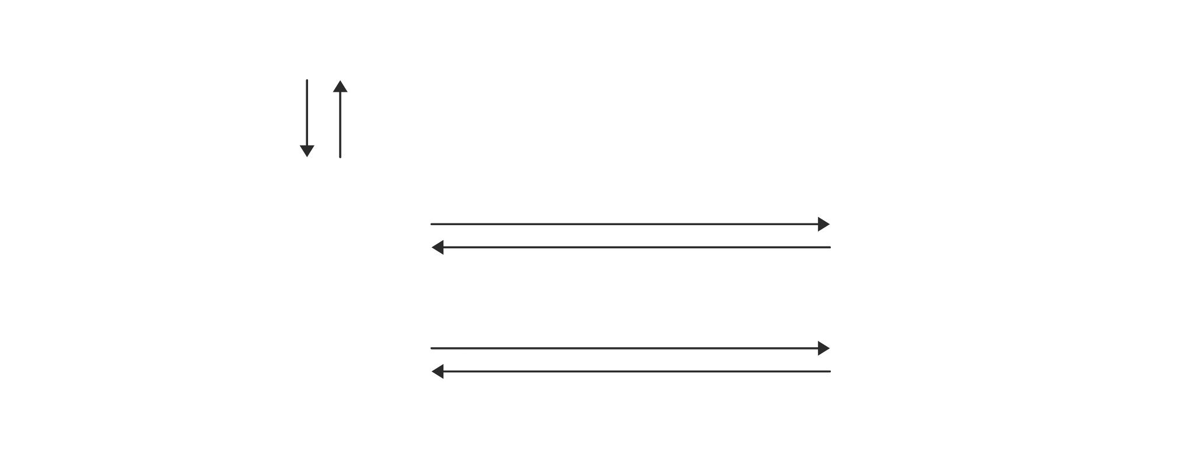
What really is MCP?
An open protocol that lets an AI application use tools and data that live in another process.

Slide 4
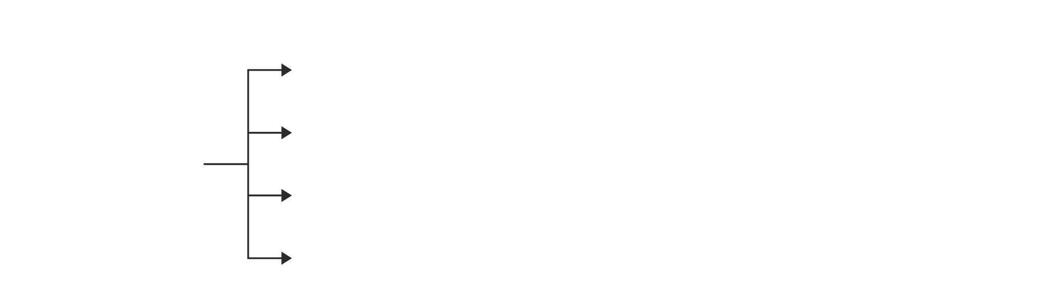
What a server can offer
The server decides what to offer.
The client decides what to use.

Slide 5
The server speaks MCP 2025-11-25
Client and server agree on the protocol version at startup, and Claude Desktop and this server settle on 2025-11-25.
Spring AI 2.0.1 and LangChain4j 1.16.3 speak the same version, so every MCP client and server in this repo agrees on it.

Slide 6
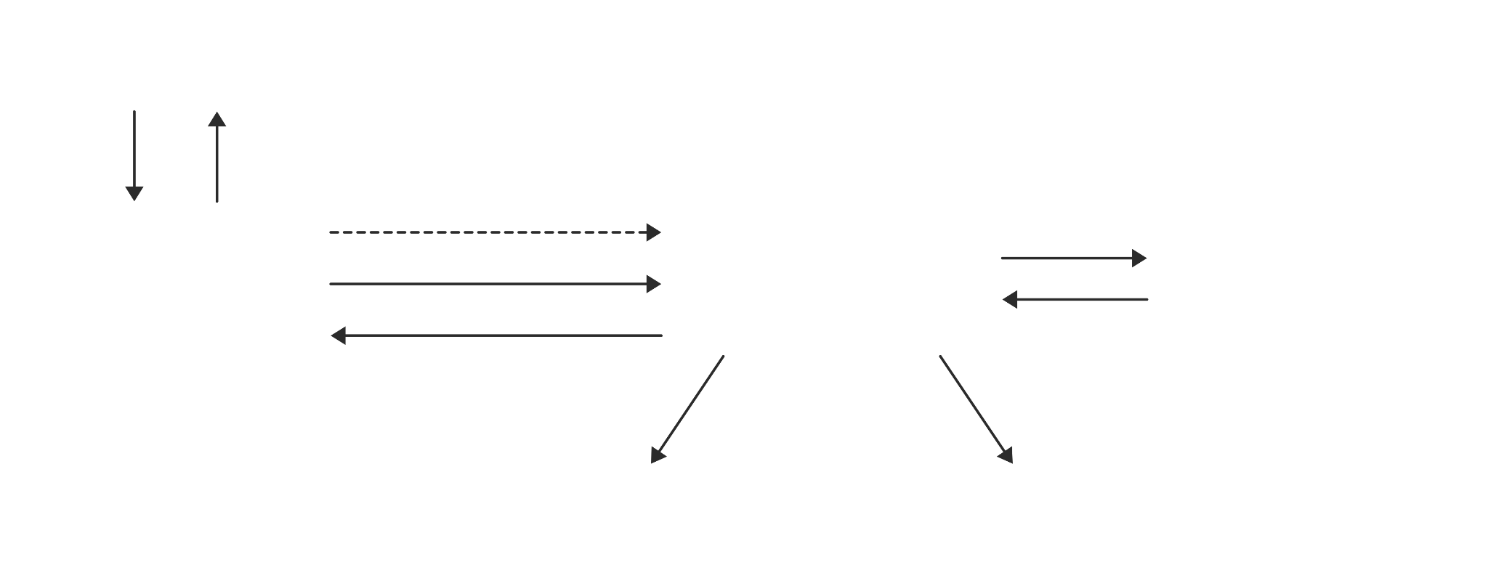
Claude + Java ♡
A copilot for your own repo, built from one Spring Boot app.

Slide 7
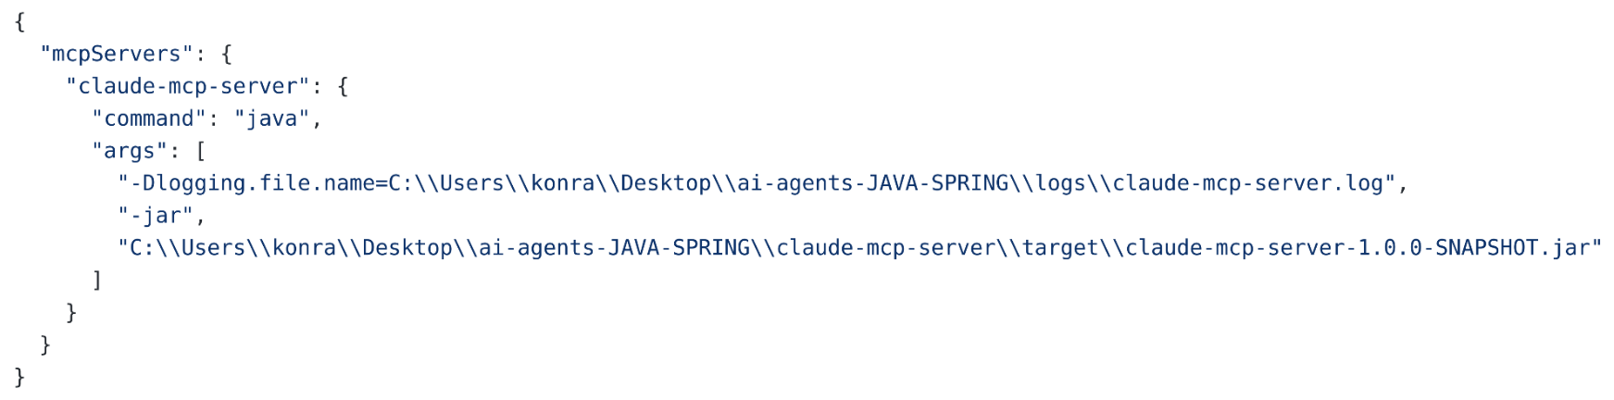
Claude Desktop setup
Add this entry to claude_desktop_config.json and restart Claude Desktop.
It starts the server itself.
Your Jar Location

Slide 8
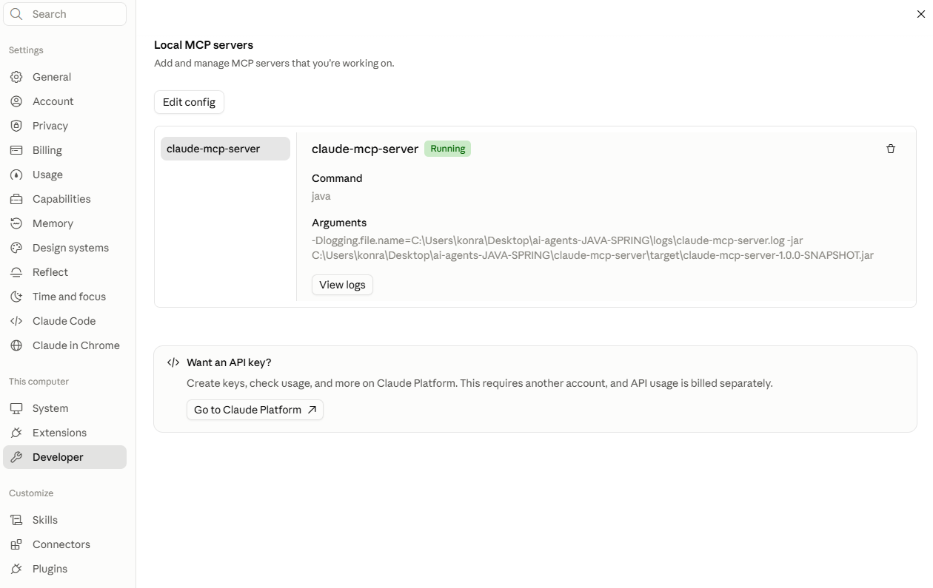
Where the config lives
Settings → Developer → Edit Config → add the entry → restart Claude Desktop

Slide 9
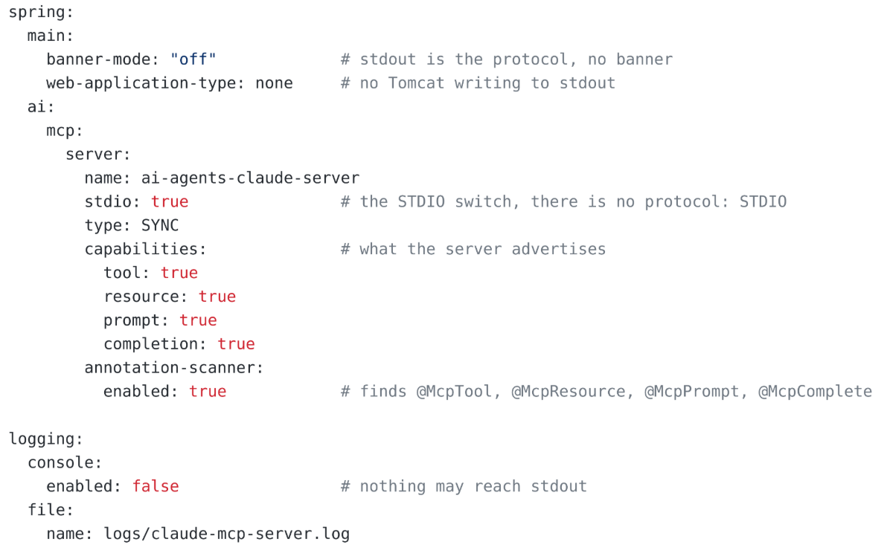
Spring Boot configuration
Three keep stdout silent
One line turns STDIO on

Slide 10

Stdout is the protocol
Every line on stdout must be a JSON-RPC message.
One log line, and Claude Desktop drops the server.

Slide 11
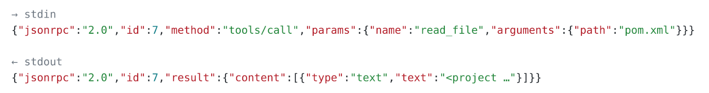
JSON-RPC
One line, one message.
A notification has no id and gets no answer.
• id → the answer comes back with the same id
• method → just a name, not code, the SDK maps it to a handler
• params.name → your @McpTool method

Slide 12
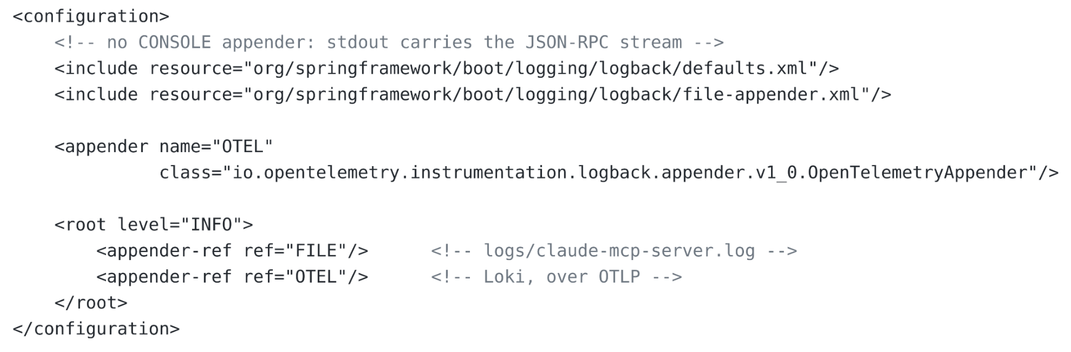
Two locks on one door
logging.console.enabled silences only Spring Boot’s default setup.
A custom logback-spring.xml replaces it, so this file simply has no console appender.

Slide 13
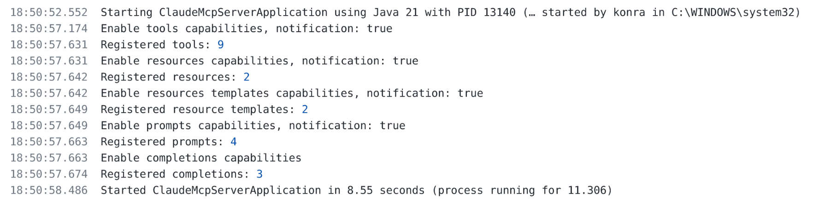
What the server announces at startup
Every capability is switched on in one line and registered in the next.

Slide 14
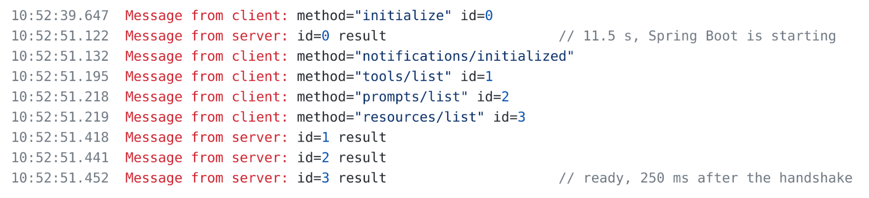
The handshake, as Claude Desktop saw it
The client waits for the JVM.
After that, three lists in a quarter of a second.

Slide 15
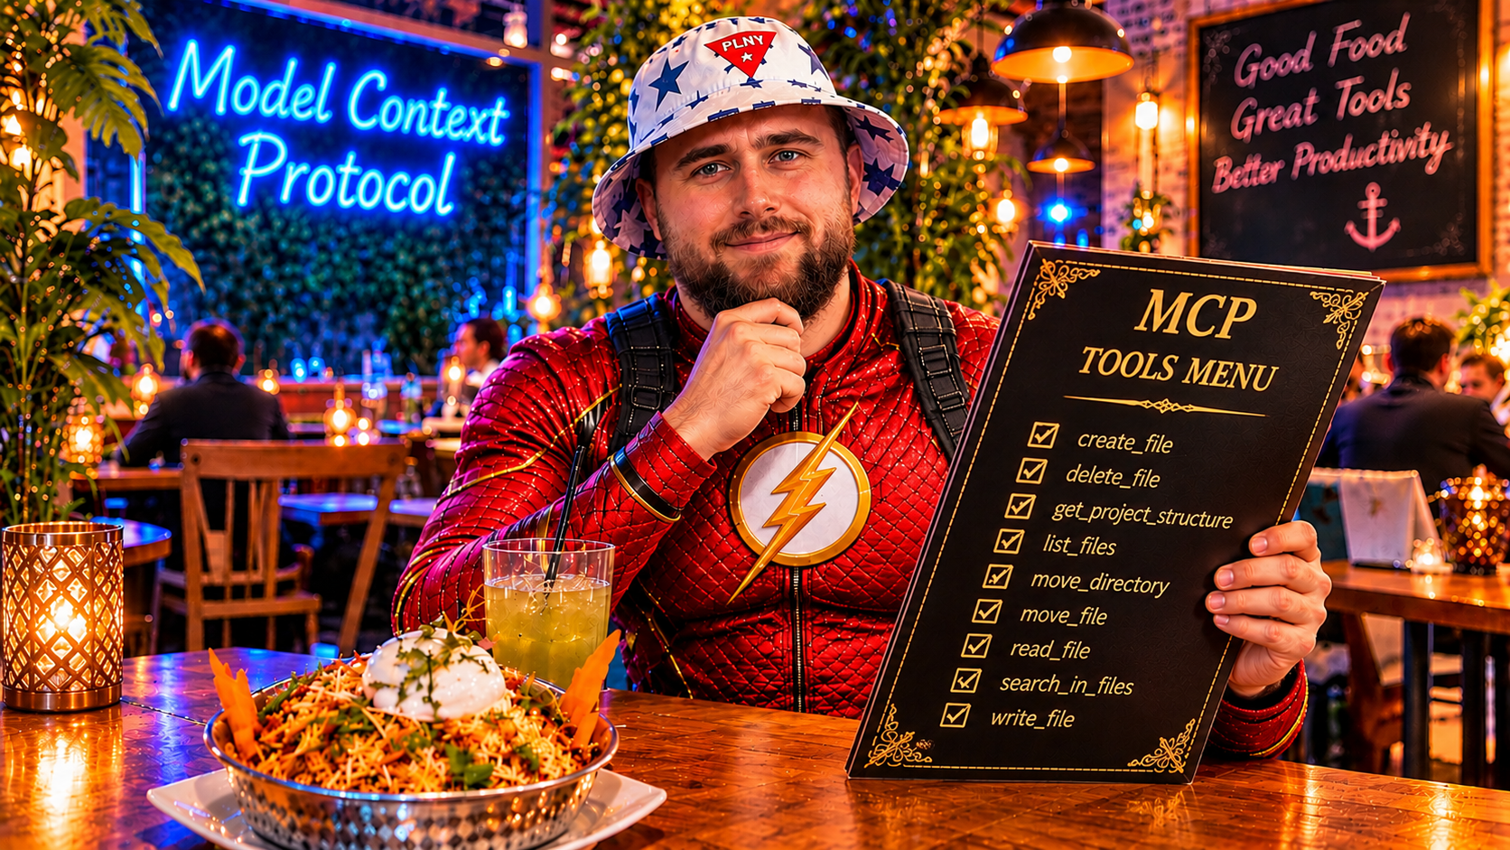
What MCP gives you

Slide 16
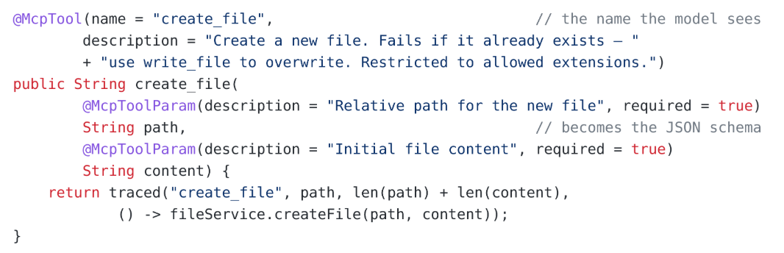
Tools
@McpTool becomes the contract.
The name, the description and the parameters are all the model will ever know about this method.

Slide 17

Nine tools, three levels of risk
Four only read, four write, one deletes.
Every tool is access you hand to a model. Give only what the job needs.
Each tool should work only inside the area it was built for, and nowhere else.
Here that area is one project folder, allowed file types only, and never .git or target.

Slide 18
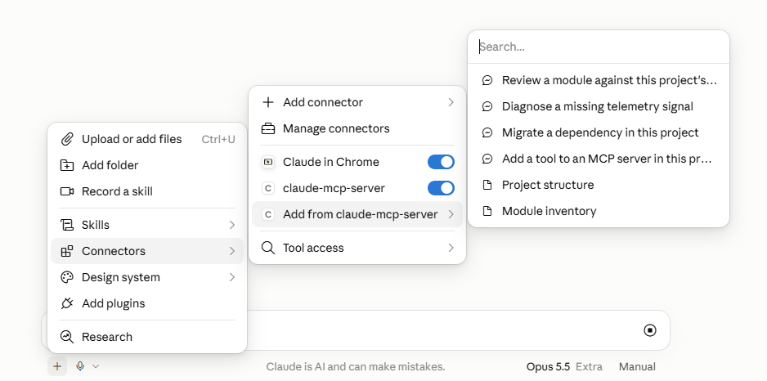
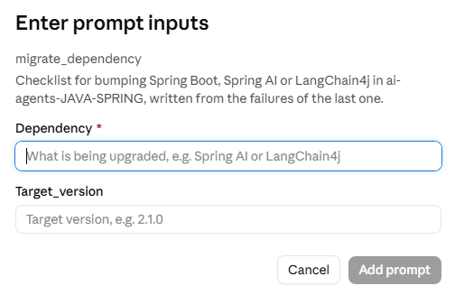
More than tools
Tools are one of three primitives, plus completions
Here are the other two, as Claude Desktop shows them.

Slide 19
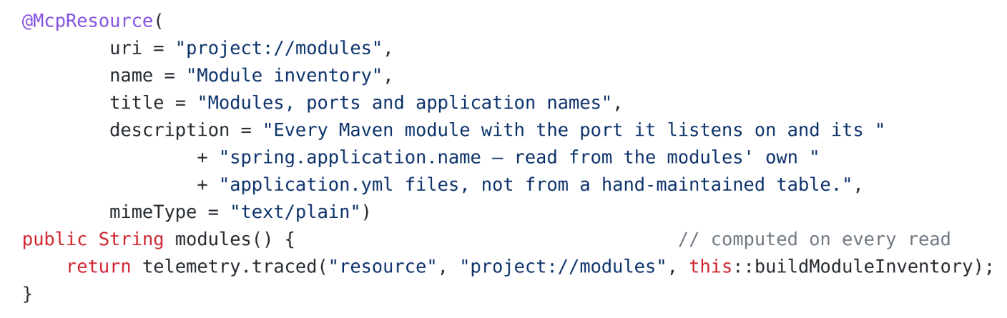
Resources
A resource can be a view
project://modules is not a file. The server builds it on every read, from each module’s own application.yml.

Slide 20
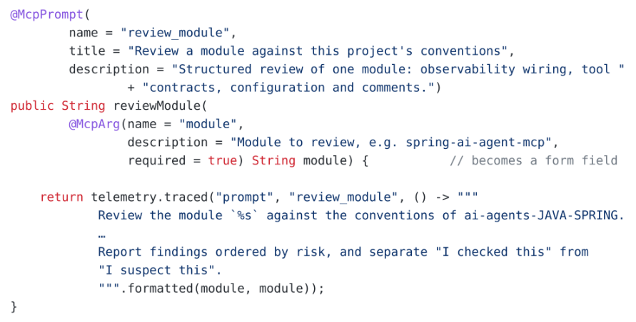
Prompts
A prompt is a message template the person fills in.
The person picks it from a menu.
@McpArg becomes the form field, and the server returns the text the model will follow.

Slide 21
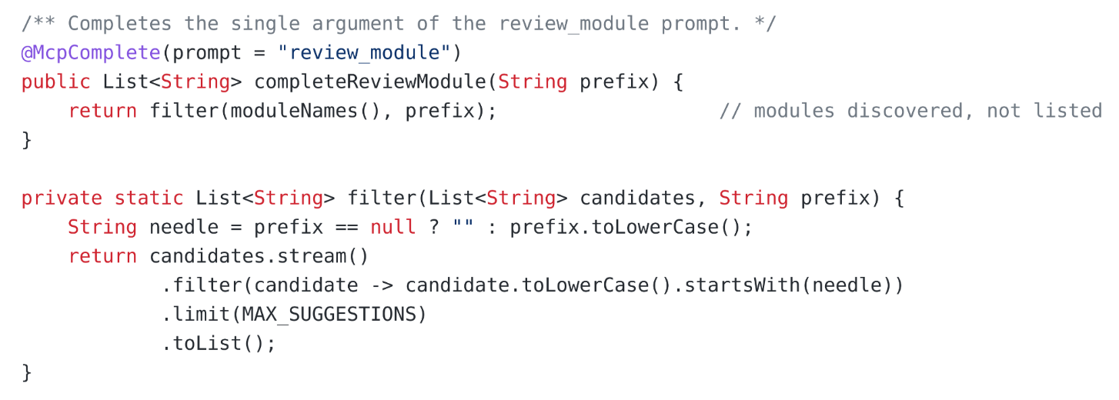
Completions
Completions help the person typing
The server suggests module names while the field is being filled in.

Slide 22
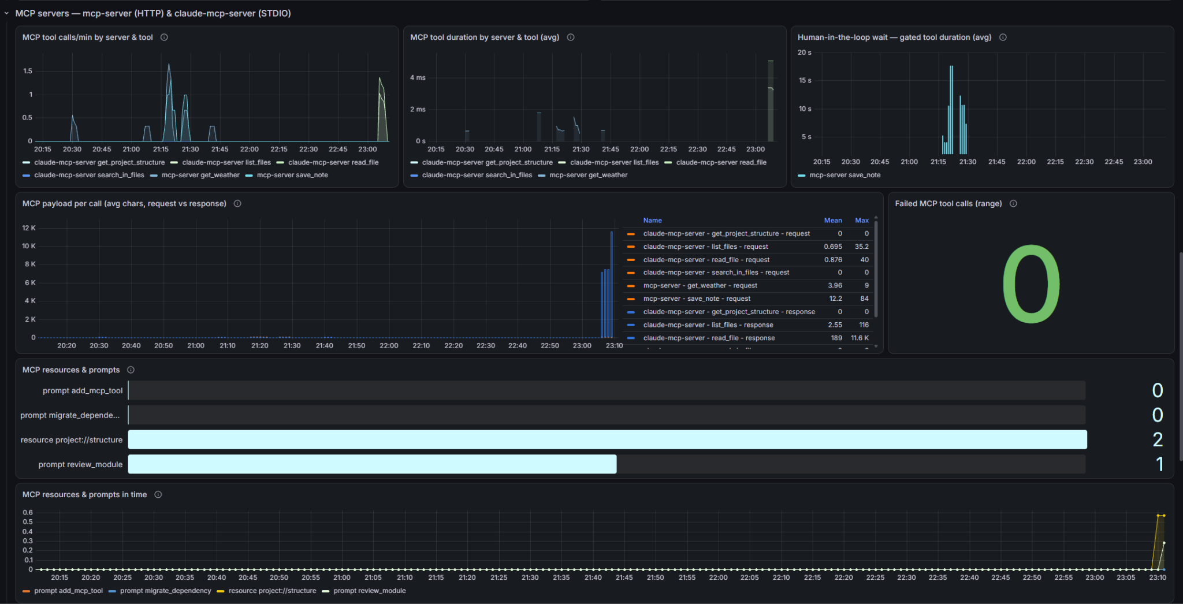
Last 3 hours

Slide 23
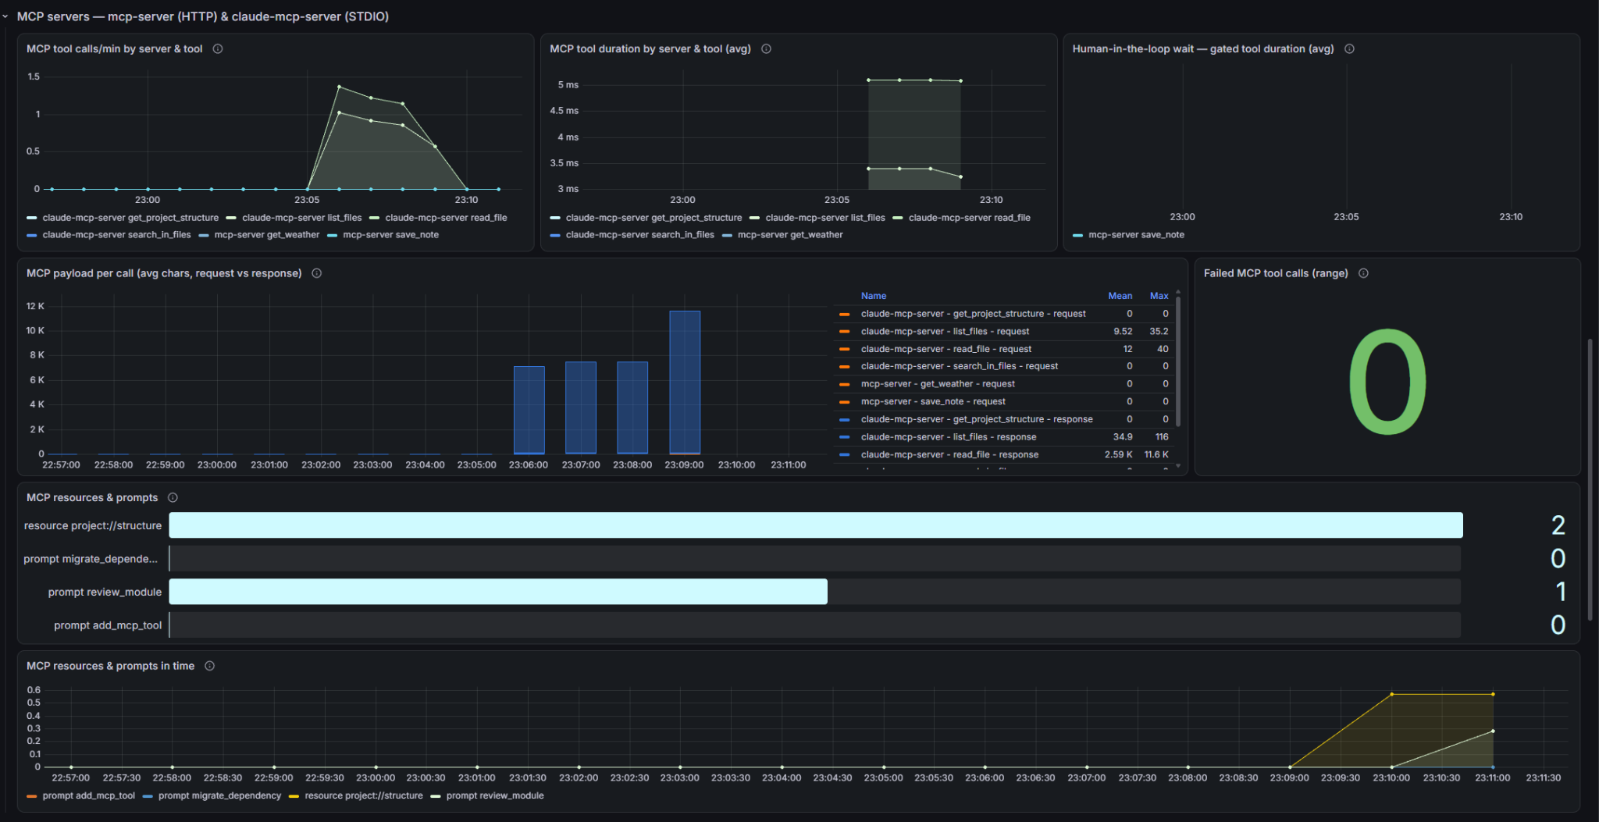
Last 15 minutes

Slide 24
From a Spring bean to Claude Desktop
Add spring-ai-starter-mcp-server to pom.xml
Put @McpTool on a method of a Spring bean
Turn STDIO on → spring.ai.mcp.server.stdio: true
Keep stdout silent → no banner, no web server, logs to a file
Build the jar → add java -jar to claude_desktop_config.json and restart Claude Desktop

Slide 25

MCP Streamable HTTP

Slide 26
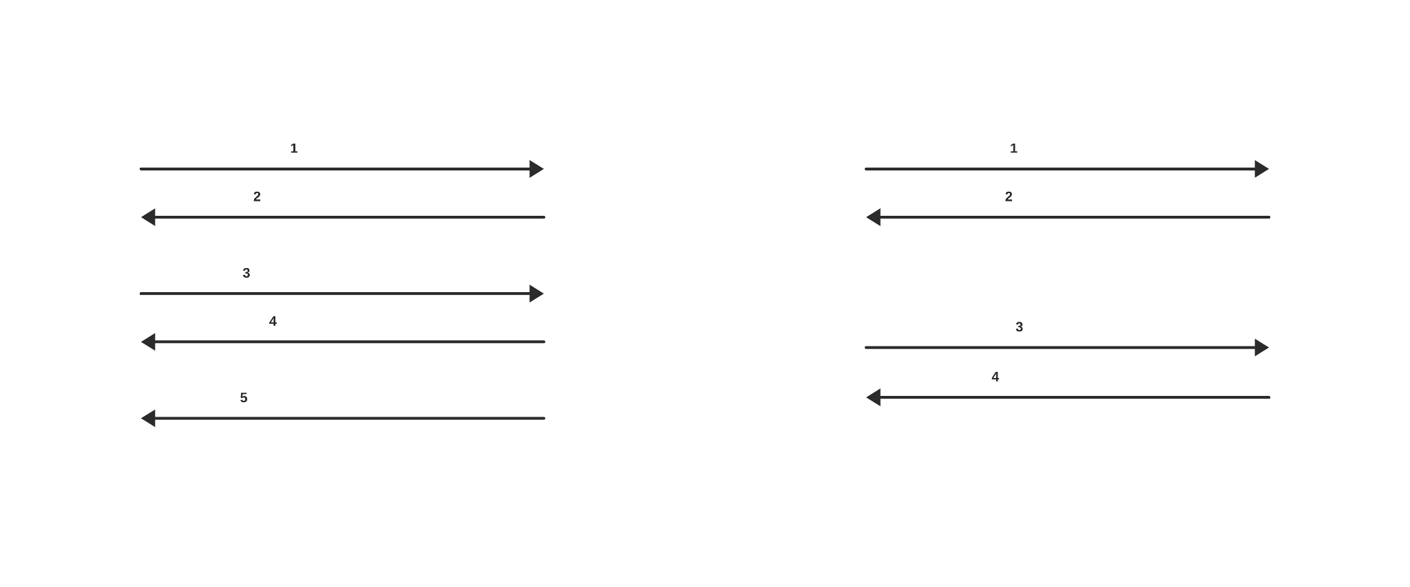
Why SSE was replaced

Slide 27
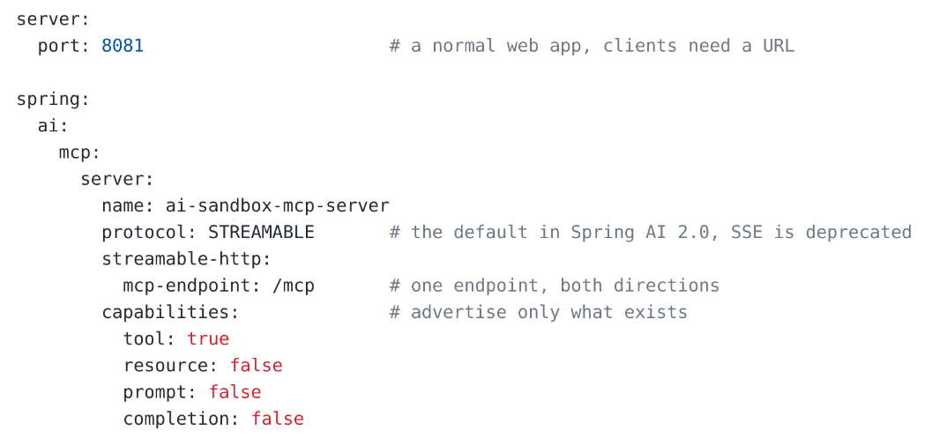
MCP over HTTP
A normal Spring Boot web app.
Same @McpTool annotation, a different transport.

Slide 28
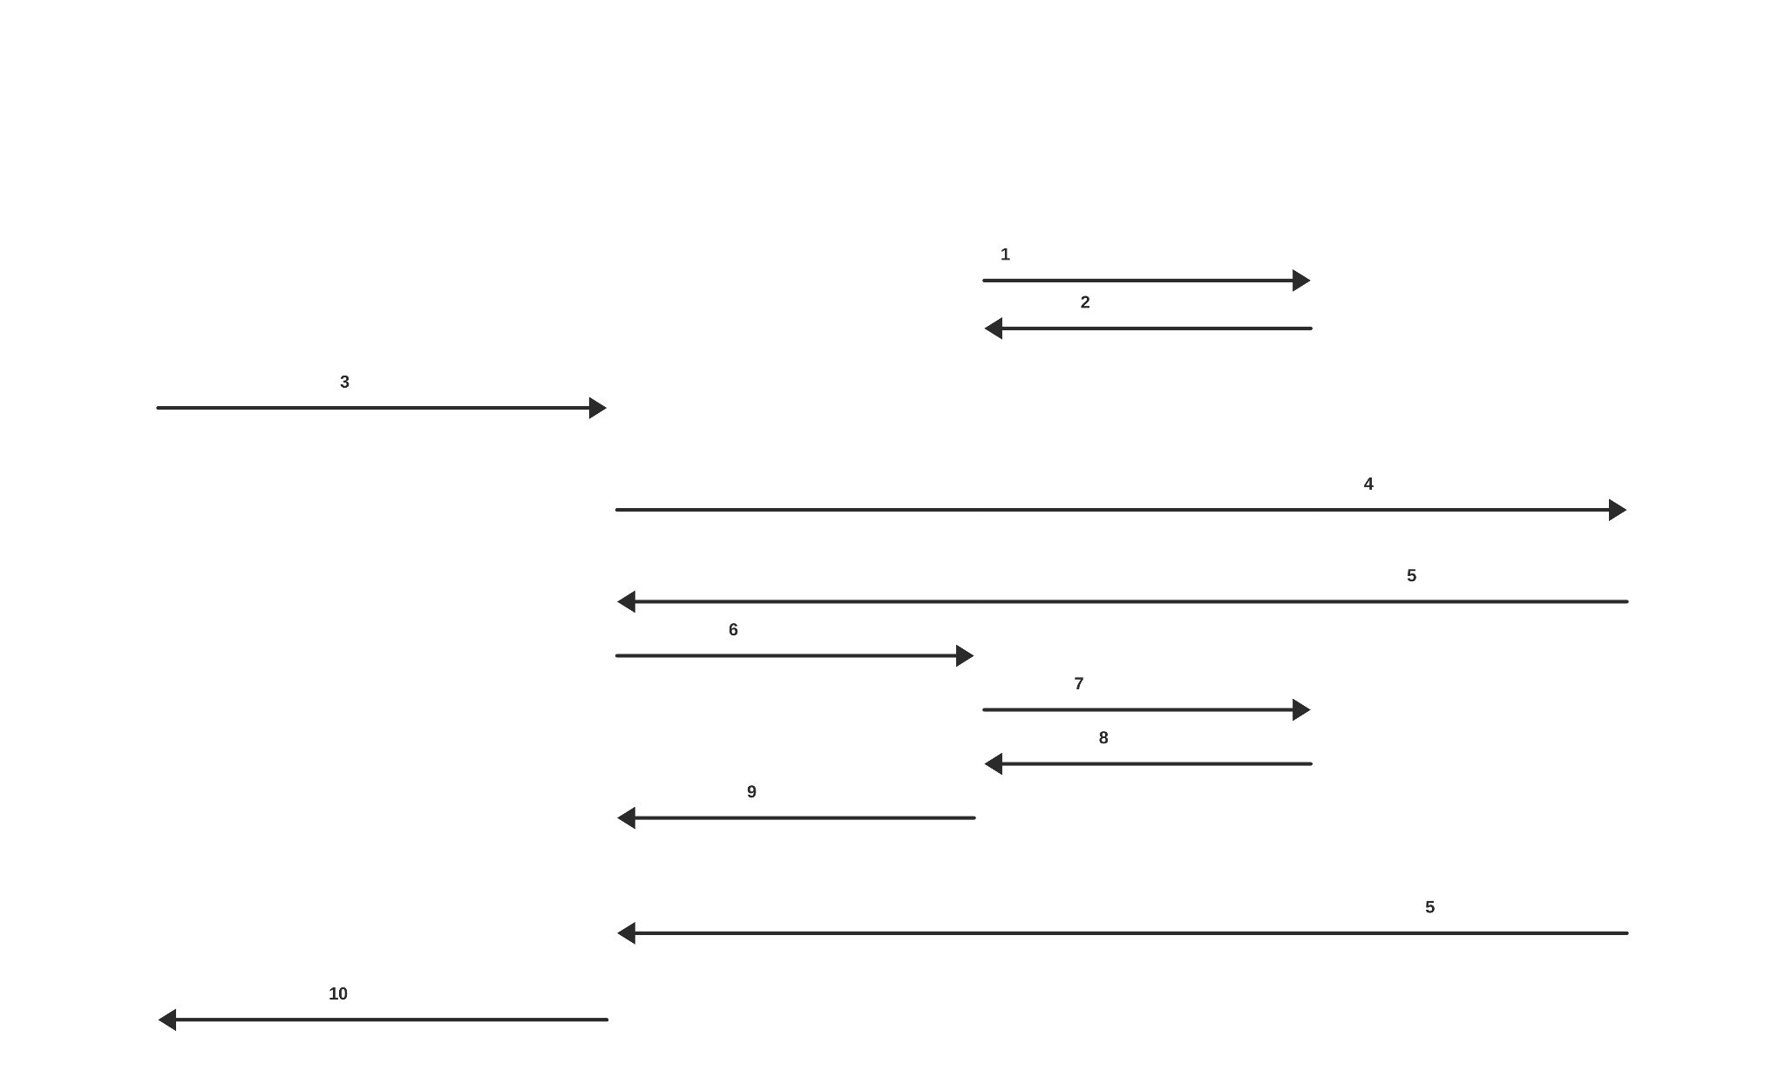

Slide 29

STDIO vs Streamable HTTP

Slide 30
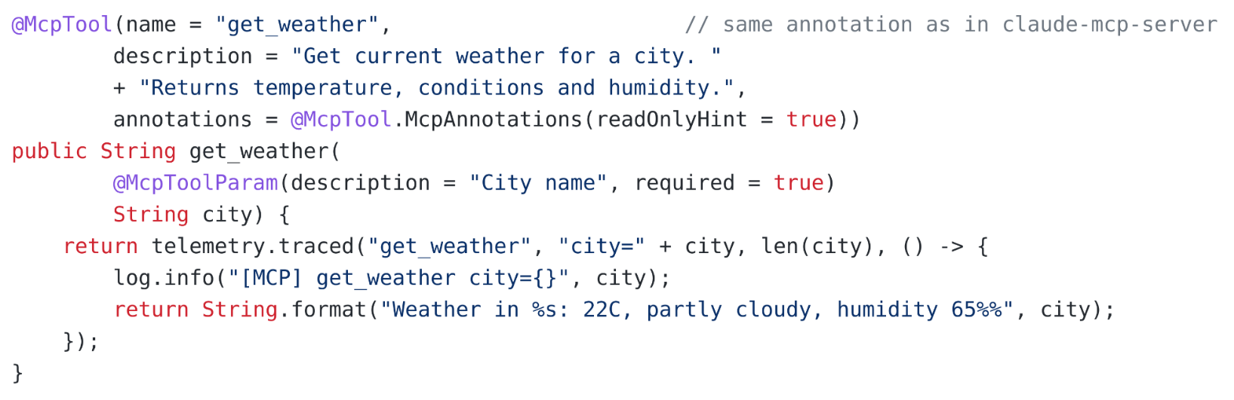
The tool every demo uses
A tool runs where the server runs.
Over HTTP, get_weather runs inside mcp-server, not inside your agent.

Slide 31
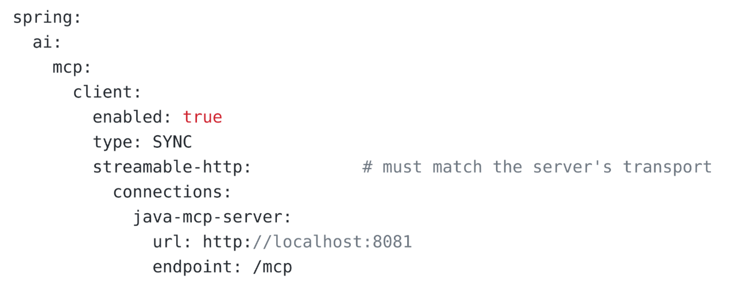
MCP Client → Spring AI
One server = one client
Every entry under connections becomes its own MCP client.
Each one connects at startup, and all their tools end up in one ToolCallbackProvider.

Slide 32
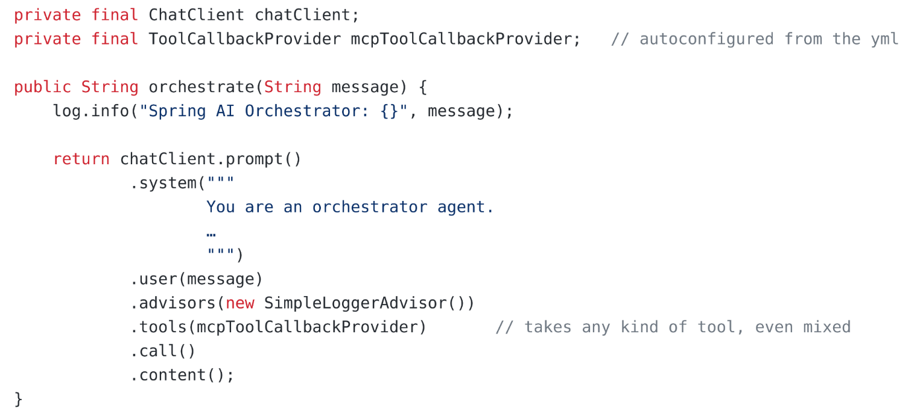
Handing the tools to the model

Slide 33
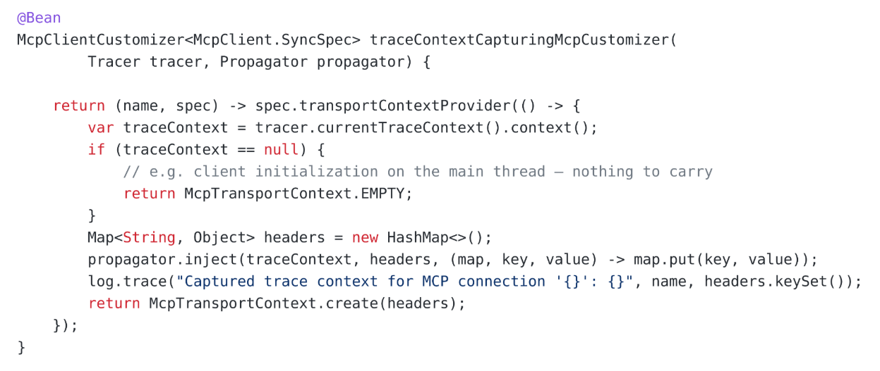
Spring AI needs two hooks
Spring Boot does not trace the JDK HttpClient inside the MCP client.
Step 1 runs on the calling thread and copies the span into McpTransportContext.

Slide 34
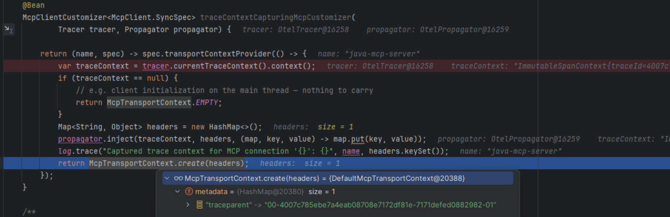
The copy holds the traceparent
The copy holds one header, the traceparent of the current span.

Slide 35
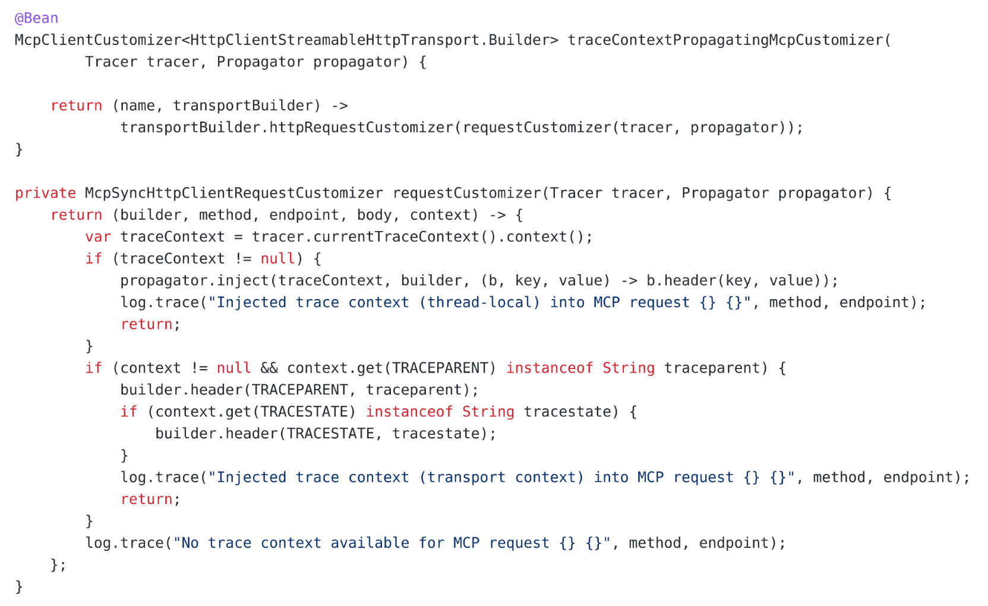
Step 2 writes the header
It runs right before every POST to /mcp.
It reads the span from the ThreadLocal, and uses the copy when the call resumes on another thread.
COPY

Slide 36
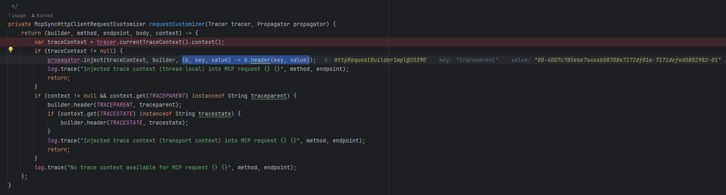
Same thread, same traceparent
The ThreadLocal branch ran, so the copy was not needed.
Same span, same traceparent as in step 1

Slide 37
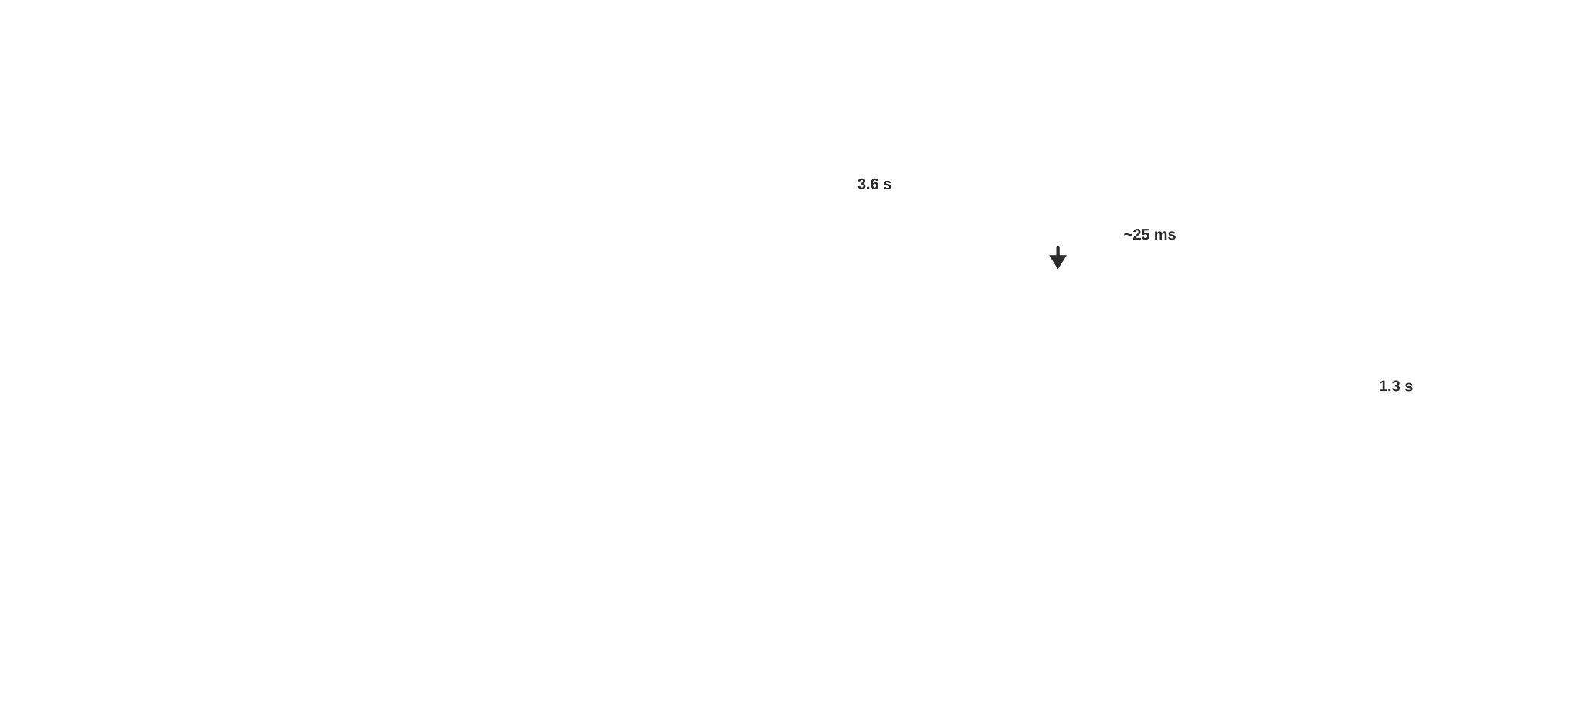
One trace, client and server
The customizer in this repo adds the traceparent header to every POST to /mcp.
MCP server continues the same trace, so spans and logs from both processes share one trace_id.

Slide 38
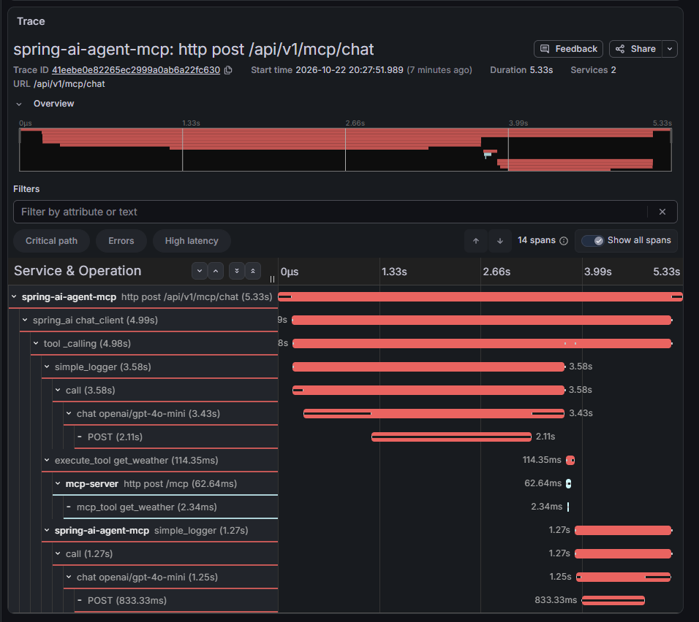
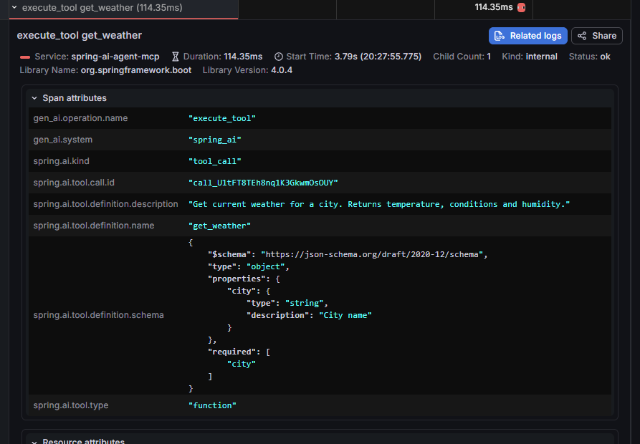
One trace, two services

Slide 39
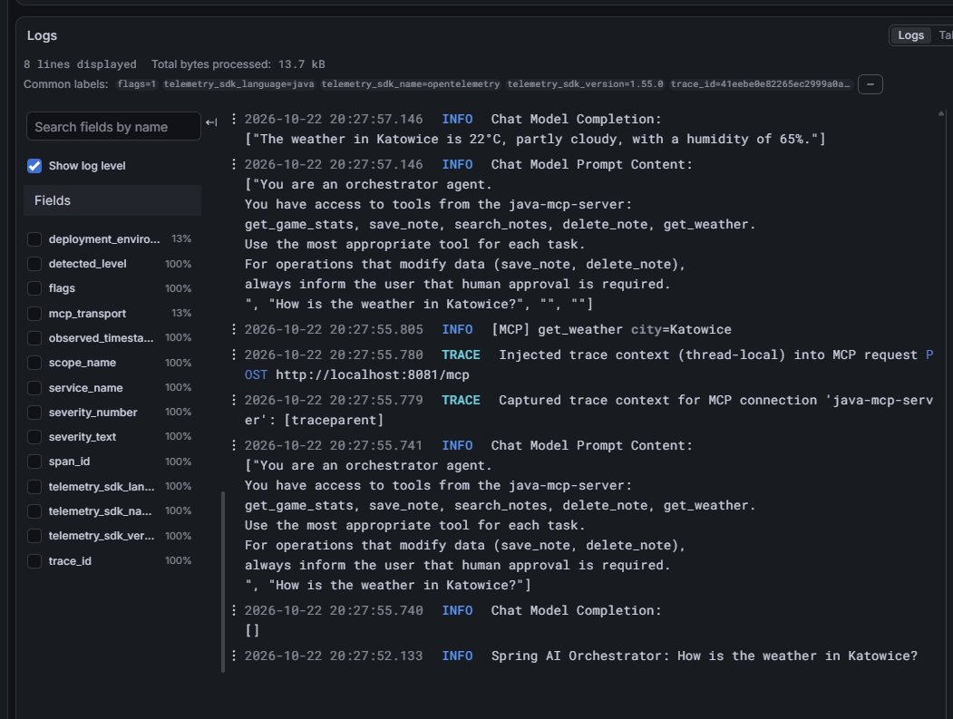
Same trace_id in the logs
Agent and mcp-server lines in one query.

Slide 40
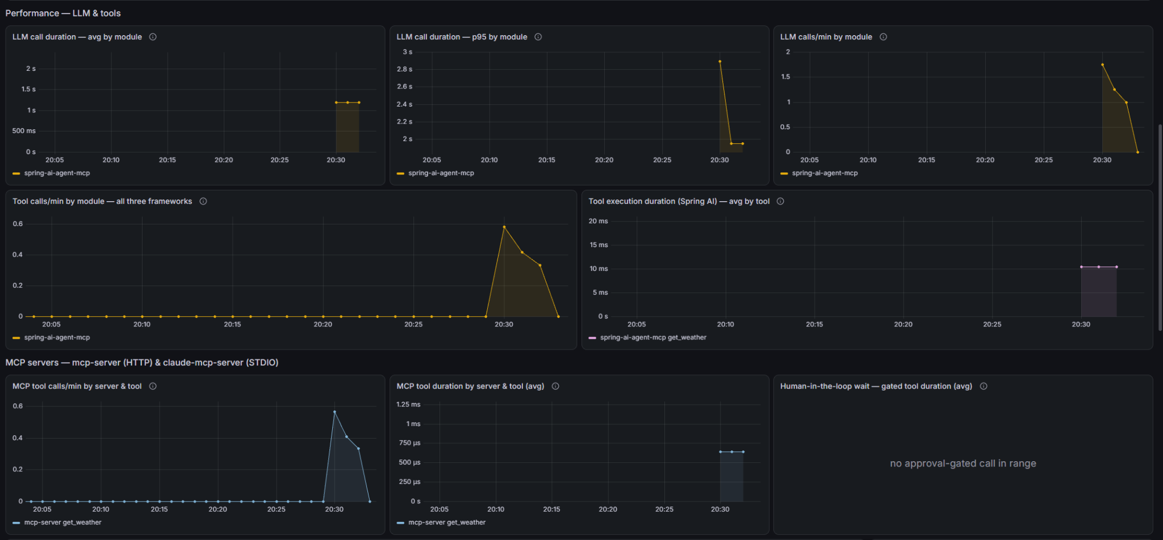
The same call in metrics

Slide 41
MCP Client → LangChain4j
One server, one client here too.
LangChain4j ships its own MCP client, not the official Java SDK.
It is built in code, and McpToolProvider puts the tools of all clients into one list.

Slide 42
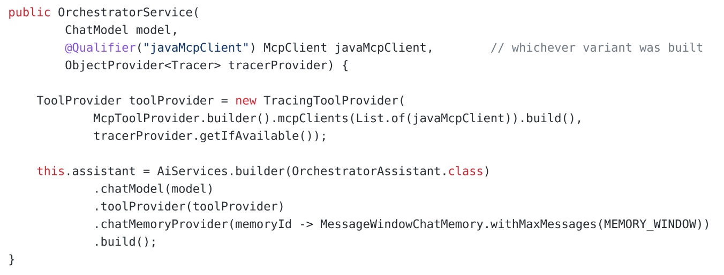
LangChain4j builds it in code

Slide 43

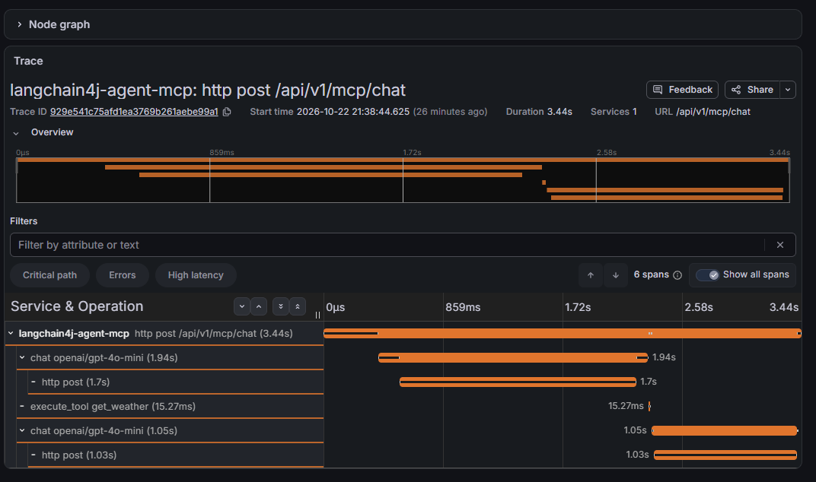
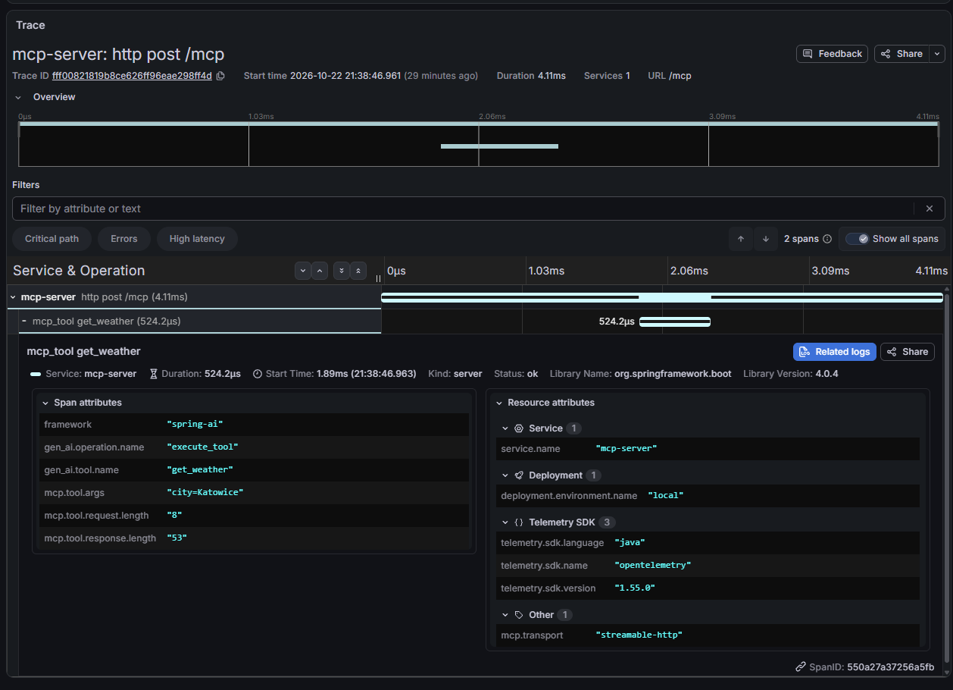
What we miss?
{ resource.service.name = "mcp-server" && name = "mcp_tool get_weather" }

Slide 44
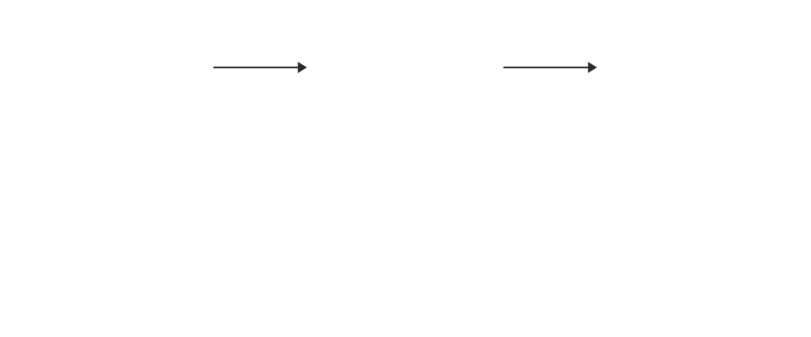
Why two traces?

Slide 45
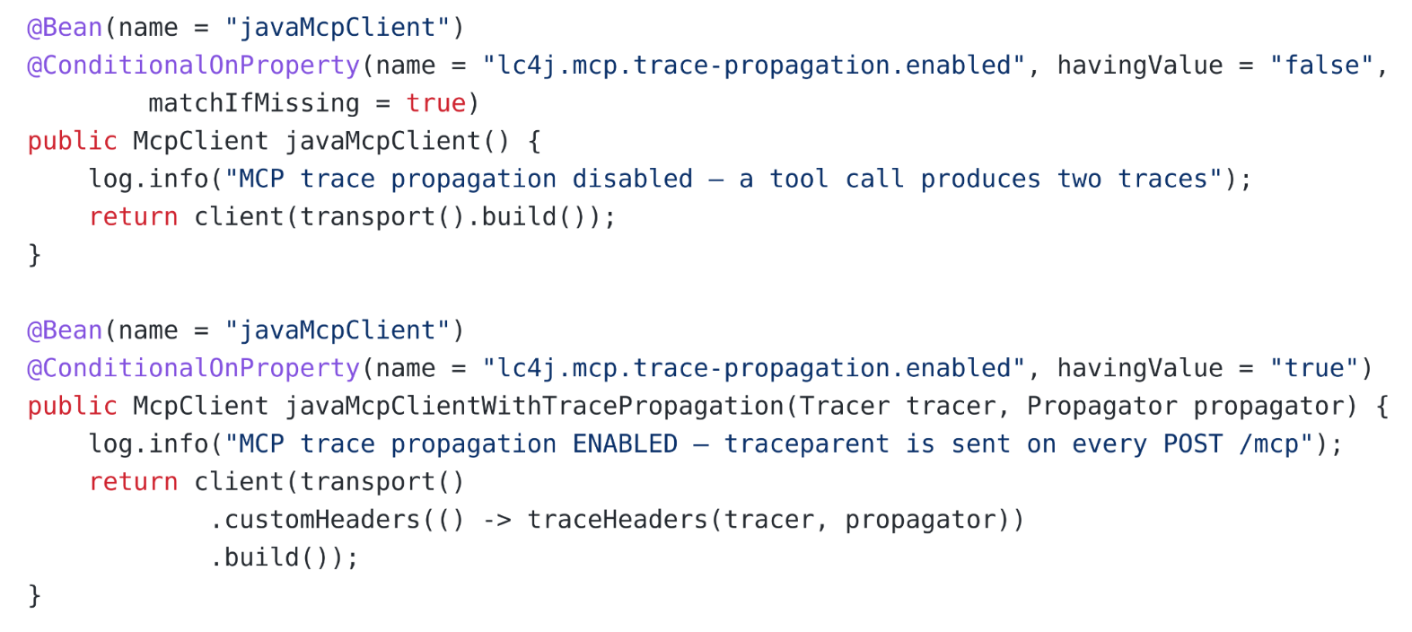
Two beans, one name

Slide 46
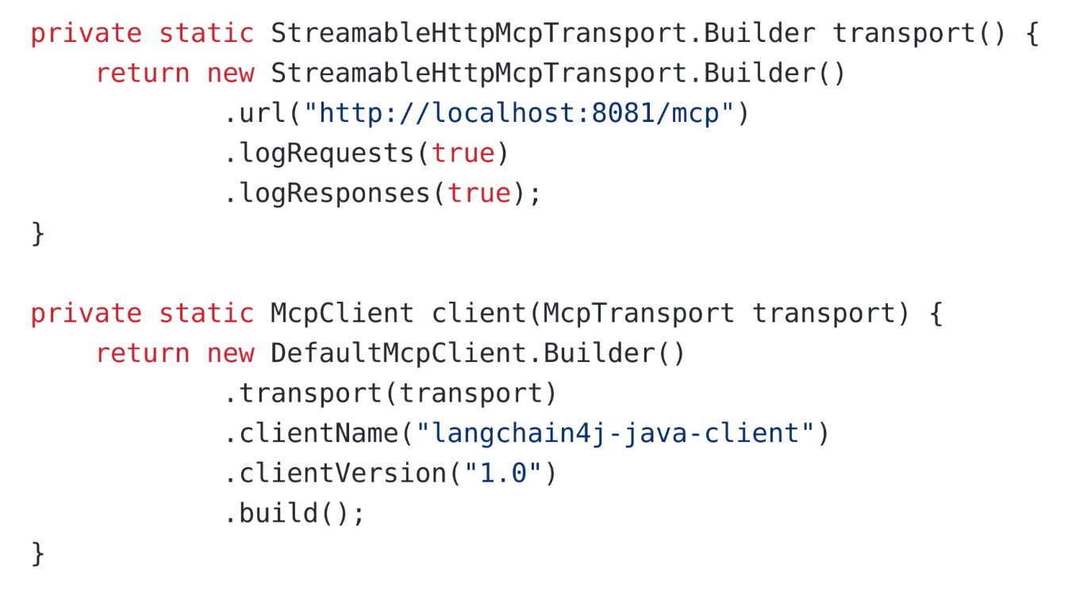
Transport and client

Slide 47
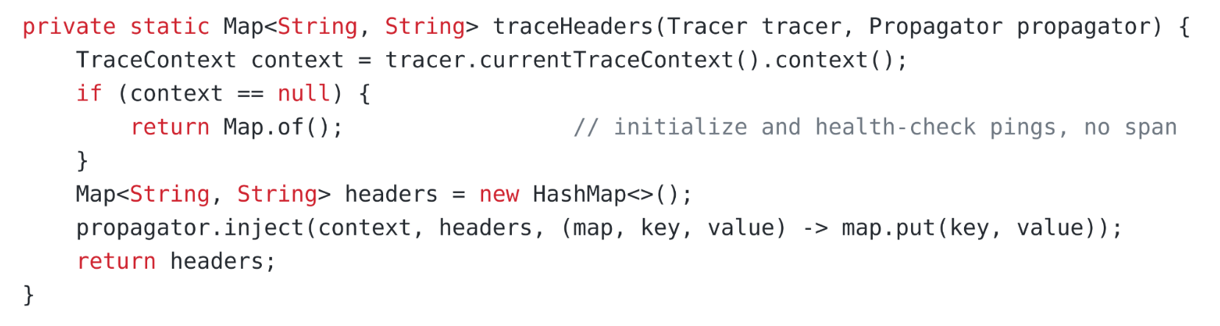
One header supplier
Called for every request, on the thread that runs the tool.

Slide 48
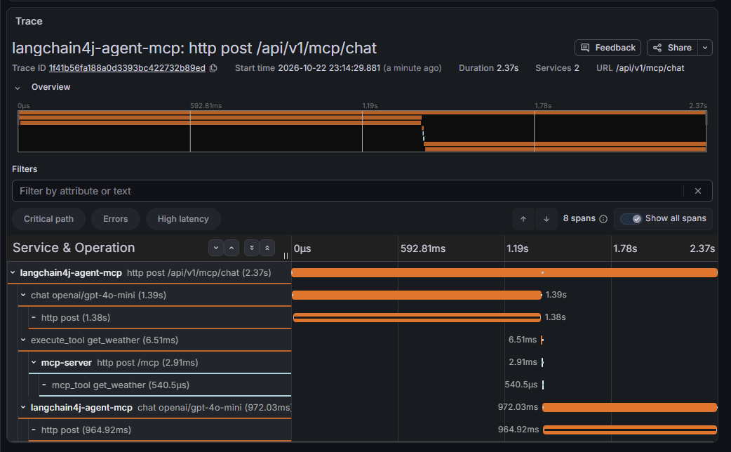
After the switch

Slide 49
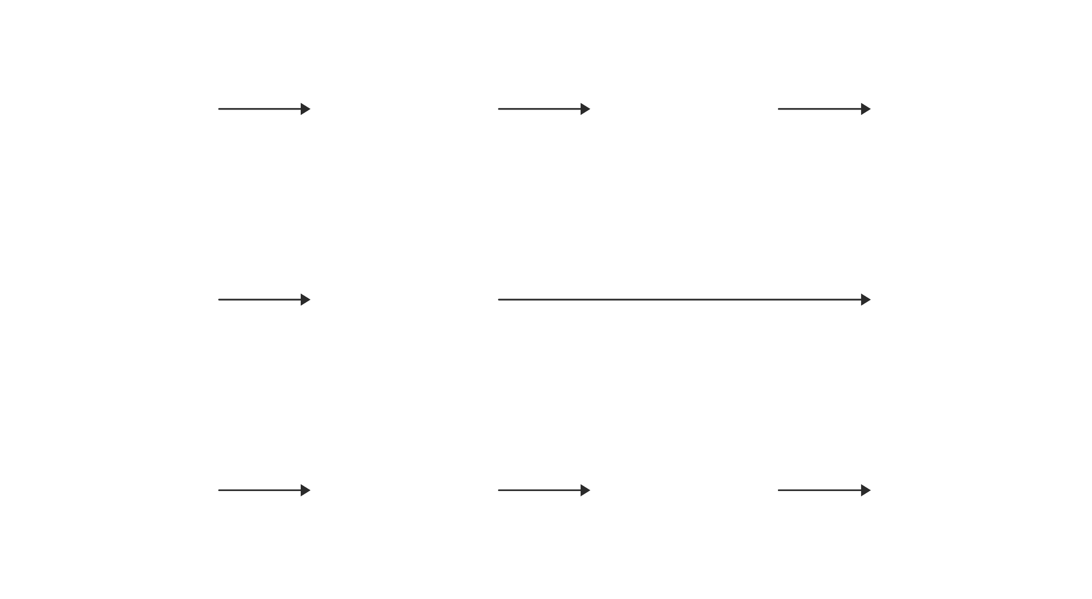
Where the trace context gets lost

Slide 50

Two clients, one protocol

Slide 51

What 2026-07-28 changes

Slide 52

Where it breaks?

Slide 53

See you in part Ⅳ next week!

